Slide 1
Projeto FakeNewzer
UI Mockup for user validation

Slide 2


Slide 3
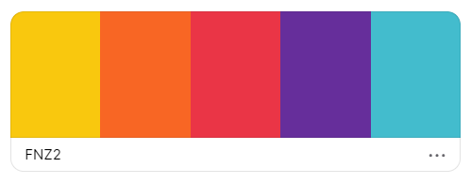


Color Palette
f9c80e
f86624
ea3546
662e9b
43bccd

Slide 4

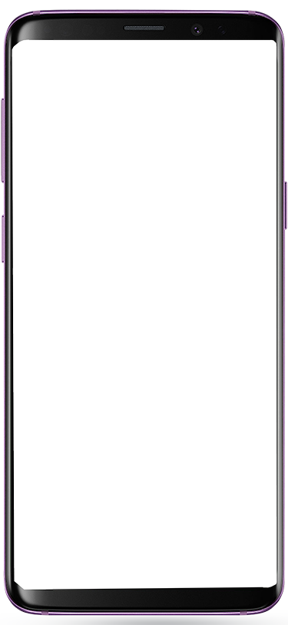

--- The game ---
new challenges every day !
Guess which
news is true and which is fake !
Facebook login
Or Play anonymously
play against FRIENDS !

Slide 5




Welcome to the
Fake newzer
Play the
new challenge
Invite your friends
your score:
13
?
RANKING
#1
Paul Travolta
18
#2
John McCartney
15

Slide 6


6/10
Time left: 0:29
New study: left-wingers are more likely to lie to get a higher salary

Slide 7
Thank you !
You scored
3/10
FAKE
Wrong answer
New study: left-wingers are more likely to lie to get a higher salary
REAL
correct answer
New study: left-wingers are more likely to lie to get a higher salary
Check links
real
Wrong answer
New study: left-wingers are more likely to lie to get a

Slide 8
Welcome to the
Fake newzer
Play the
previous challenges
Invite your friends
your score:
16
?
RANKING
#1
Paul Travolta
18
#2
YOU
16

Slide 9

Previous challenges
June – 2020 - #3
(done)
June – 2020 - #2
(done)
June – 2020 - #1
May – 2020 - #4
(done)
May – 2020 - #4
(done)

